Slide 1
Writing an executive summary
Marisa Mason
NCEPOD

Slide 2
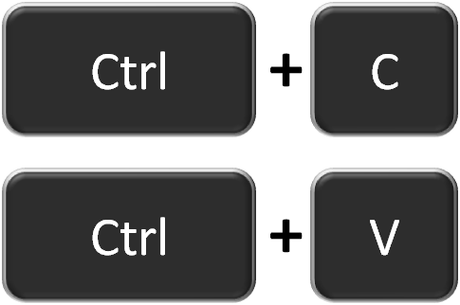
My brief...
  ‘10 top tips for writing an executive summary...’

Slide 3
Consultation
Approximately 10% of the length of the main report
Written in language appropriate for the target audience
Consist of short, concise paragraphs
Include a summary
Written in the same order as the main report
Only include material present in the main report
Make recommendations
Provide a justification
Have a conclusion
Be readable separately from the main report

Slide 4
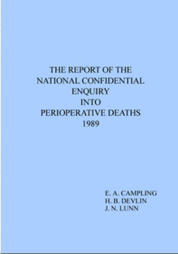
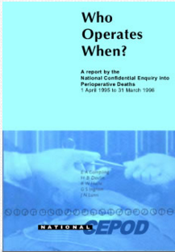
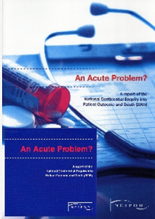
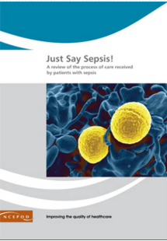
Not always the case
4 pages
6 pages
16 pages
23 pages
Why have an executive summary?

Slide 5
For the benefit of the reader
What are the main messages?
What key findings support those messages?
How was data collected?
What was the reason the project was undertaken

Slide 6
For the benefit of the provider
Use it as a basis for discussion prior to publication
  Professional contacts
  Media contacts
Summary can only be as good as the main report
  Consider it at the project start when designing the study and impact planning

Slide 7
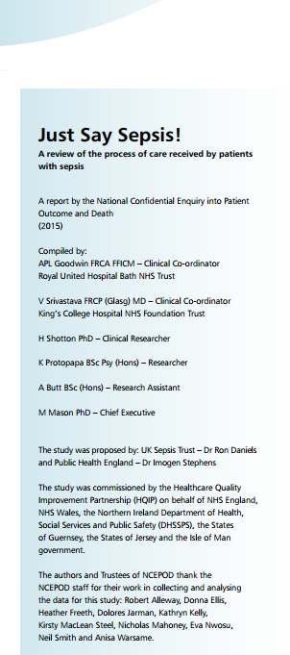
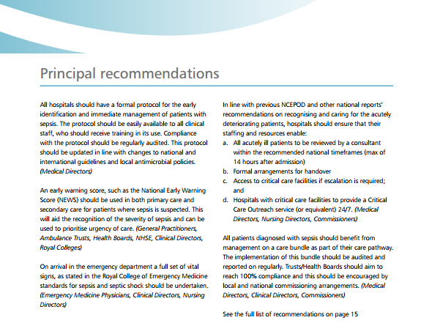
The most important facts first

Slide 8
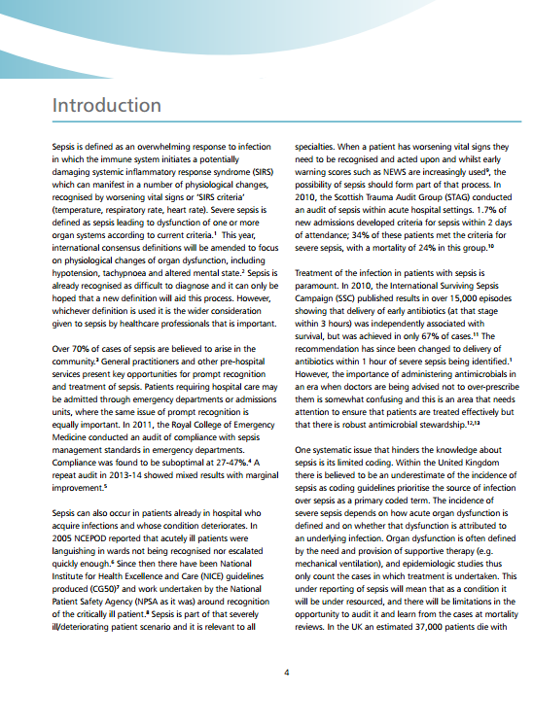
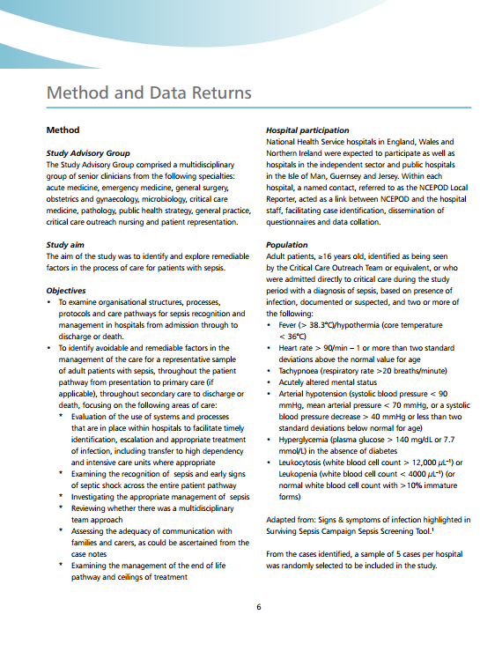
Introduction & method

Slide 9
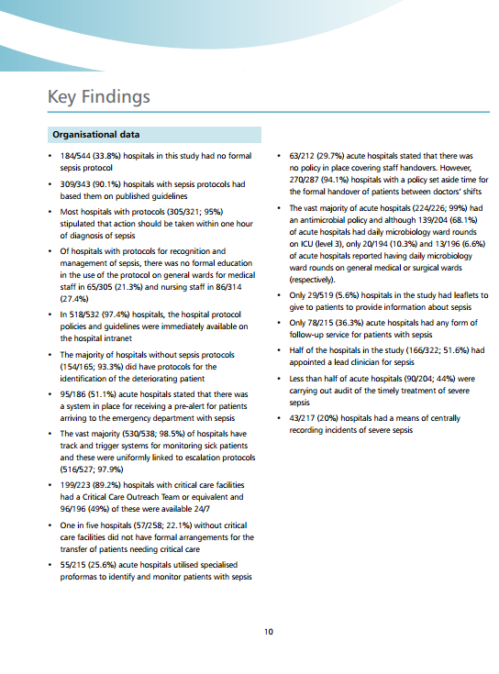
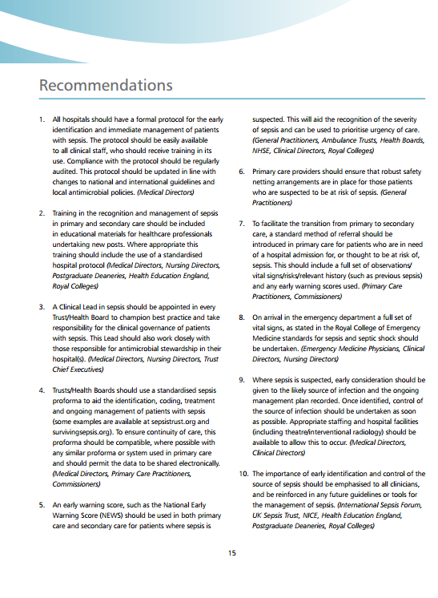
Key findings & recommendations

Slide 10
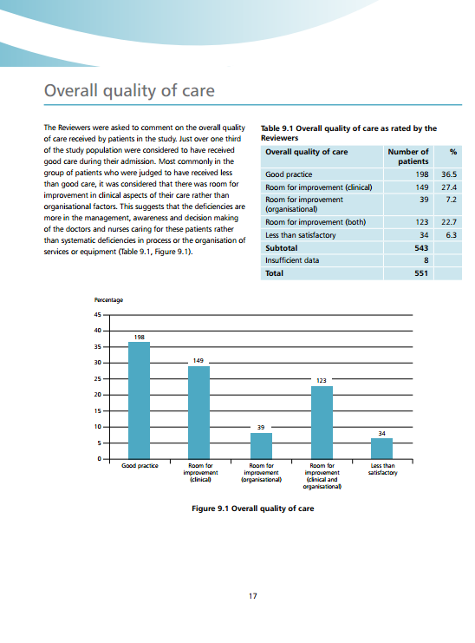
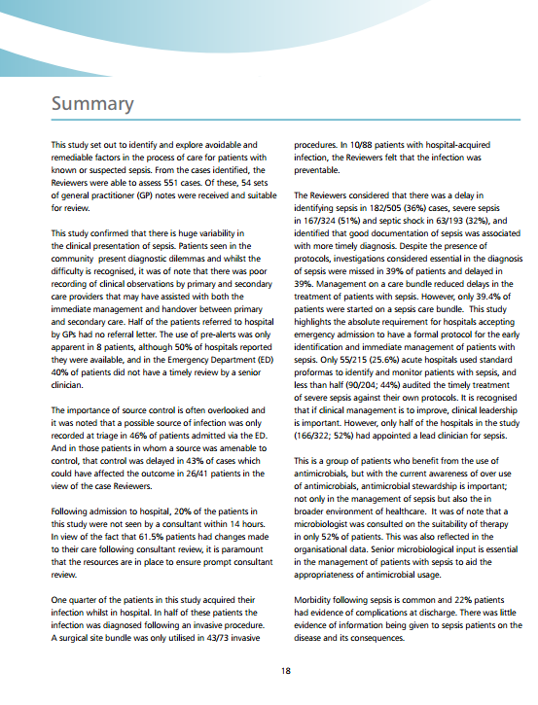
Summary

Slide 11
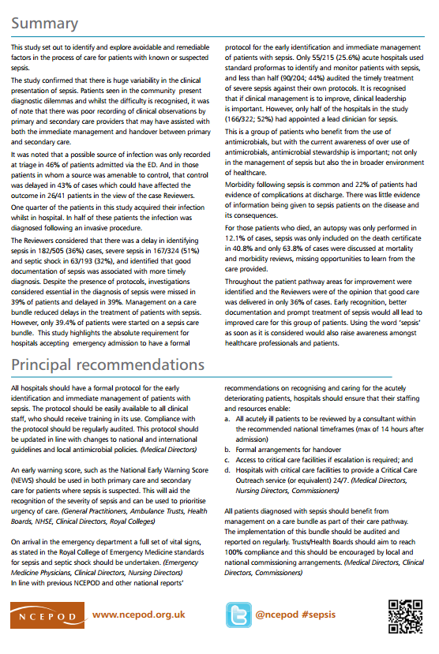

Executive summary, summary

Slide 12
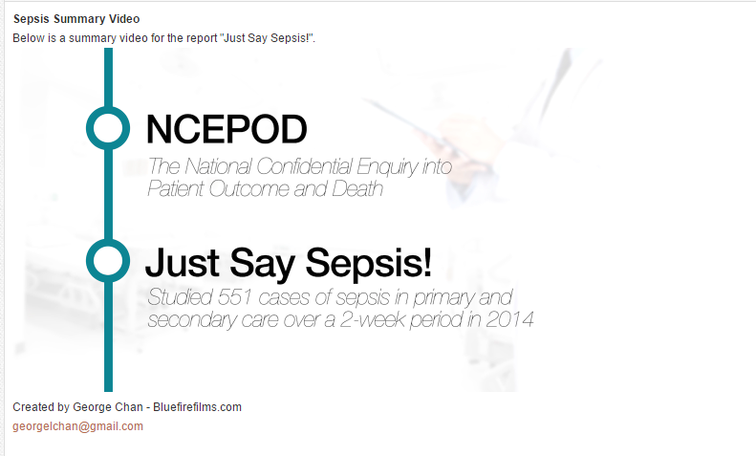

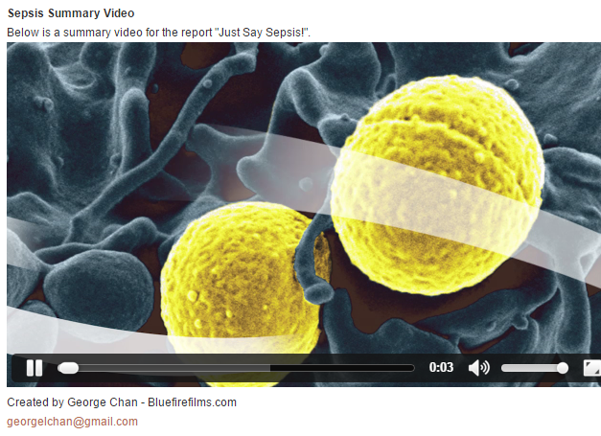
Or you can be a bit flash...

Slide 13
My top 10ish tips
Put the most important messages first
Introduce the report and list any references used
Summarise the method
Include participation
Include all key findings
Include all the recommendations

Slide 14
My top 10ish tips
Provide a summary of the report
Keep key data in the same order as chapters in the full report
Only include content from in the main report - CTRL C + V
Keep style and artwork consistent
Write it last
Don’t forget to make changes that are made to the full report

Slide 15

Thank you

